Slide 1
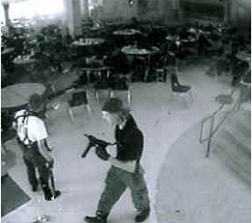
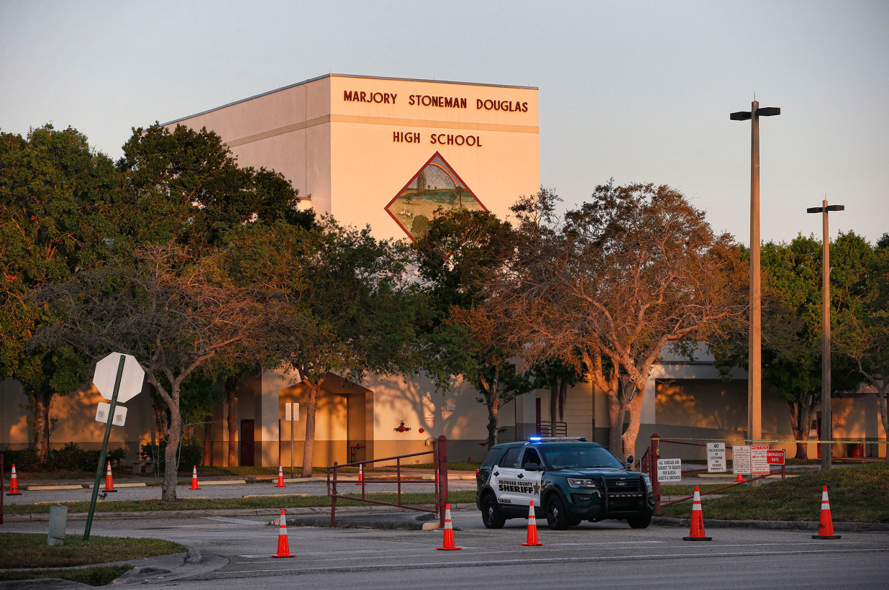
Columbine 4/20/99- Parkland 2/14/18
LESSONS LEARNED ?
13 DEAD 21 WOUNDED
17 DEAD 17 WOUNDED

Slide 2

FBI 2014 Active Shooter Study
64 incidents studied—44 ended in 5 minutes or less 69%
160 Incidents studied—104 ended before responders arrived on scene 66.9%

Slide 3
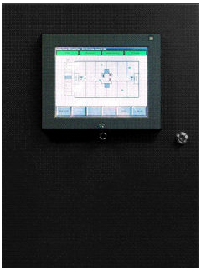

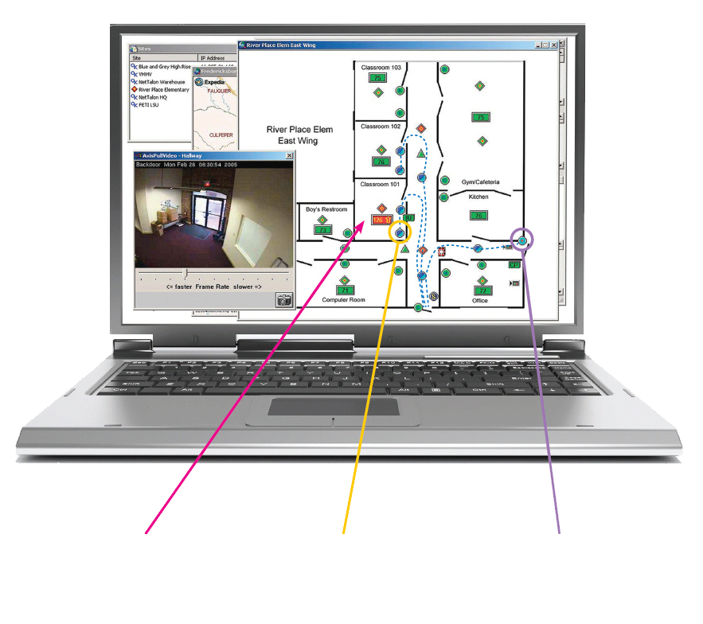

Virtual Command® – Networked Based Integrated Information System
February 27, 2007 NetTalon obtained UL approval for Security and Fire.
UL 864 9th Edition
UL 1076 5th Edition
UL 2017
UL 1076
Fire Alarm, Security, and General Signaling Equipment
2001 patent, 2005 patents 2015 patent
DIGITAL TEMPERATURE SENSOR
REAL-TIME TRACKING
ACTIVE MOTION SENSOR
CONTROL PANEL
DIU
MONITORING

Slide 4

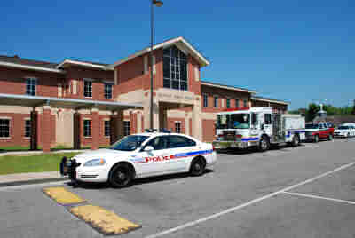
Virtual Command – Designed to Connect Law Enforcement to a School for Incident Response
Supplemental UL Approval
Remote Monitoring &
Emergency Response Stations
Nov 2009
Virtual Command Network
911
IP
Radio Alert
Actionable Intelligence
Radio Comms
School WIFI
Actionable Intelligence

Slide 5


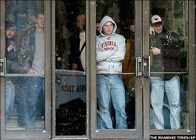
Virtual Command – Active Shooter Counter
Innovated in Response to the VA Tech Massacre
VA Tech Mass Shooting April 16th 2007
32 Killed, 17 Wounded

Slide 6
A prototype Incident Response System to Resolve a Life Threat Incident with Minimum Casualties
Alerting LE within 5 seconds of “Shots Fired” with electronic notification enables responders to arrive on the scene at the 3-4 minute mark intercepting the shooter’s attack.
True Safe Havens (fortified doors) in the Building denies the attacker easy access to victims.
Virtual ability to locate and track the attacker in the building while responders are en-route. Facilitates incident planning on the fly.
Enables the earliest possible contact with the shooter once responders are on the scene.
Aggressive pursuit of the shooter forces a quick end to the incident.

Slide 7
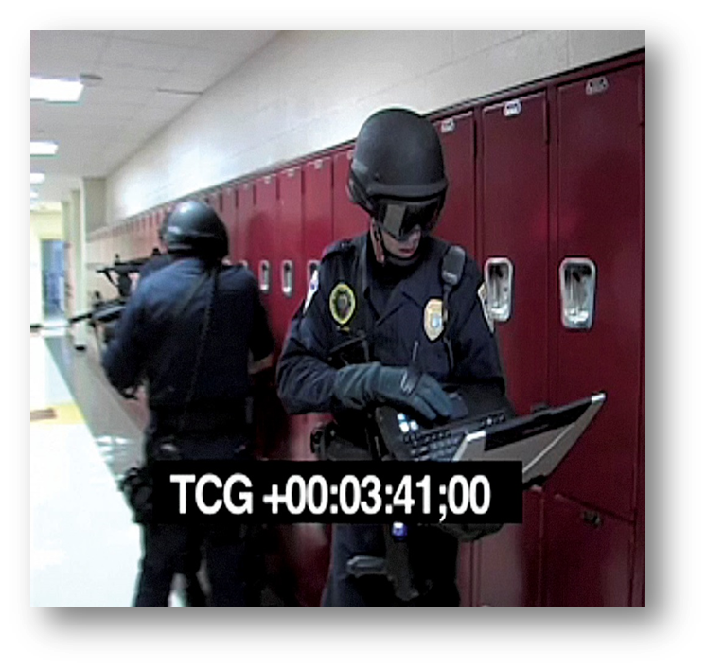
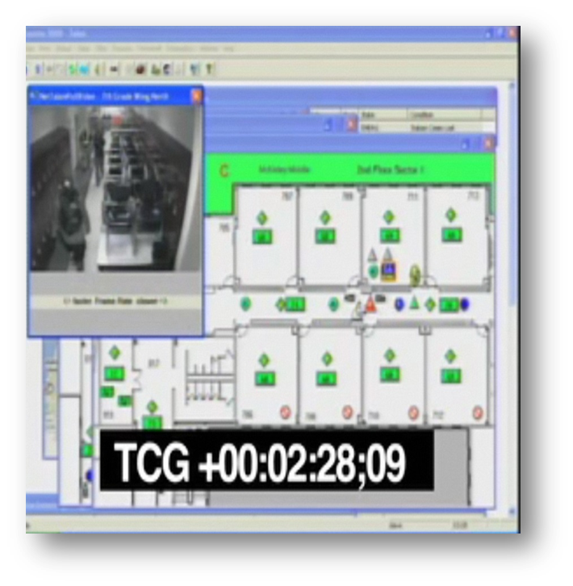
Virtual Command – Active Shooter Counter
Baton Rouge, LA Comparative Test
Responders have real-time actionable intelligence
System provides continually updated information
Responders can use system to monitor multiple attackers in real-time with no system degradation
BUILDING ENTRY TEAM TRACKING SHOOTERS
ACTIONABLE INTELLIGENCE

Slide 8
Virtual Command – Active Shooter Counter
Comparative Tests
Conventional 11 Dead, 14 Wounded
VC 1 Dead, 1 Wounded
Conventional 23 Dead, 24 Wounded
VC 1 Dead, 4 Wounded

Slide 9
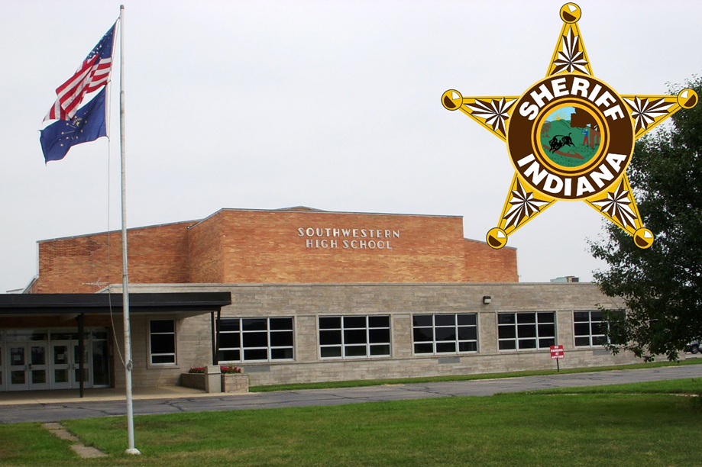
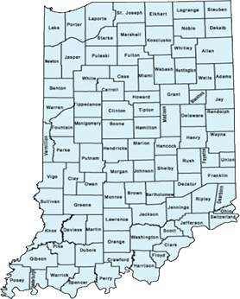
Protected by “Best Practice Solution” -- the Highest Standard for School Safety.
Southwestern Consolidated High School is the first school in America connected 24x7 directly to law enforcement---the Shelby County Sheriff’s Dispatch Center. The system was unveiled on September 11, 2014. It received National notoriety in 2015 with the NBC Jeff Rossen Report
https://youtu.be/a2ewuHvoIDA
-
Indiana School Safety Bill, Senate Bill 147 passed March 2016—Signed into Law by Gov. Pence-- Public Law 27 –effective July 01, 2017—Encourages all schools to implement a similar system

Slide 10
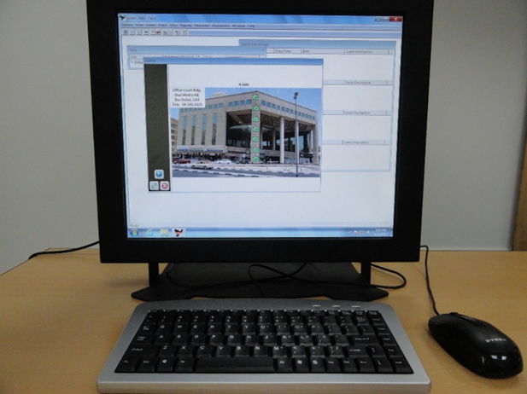
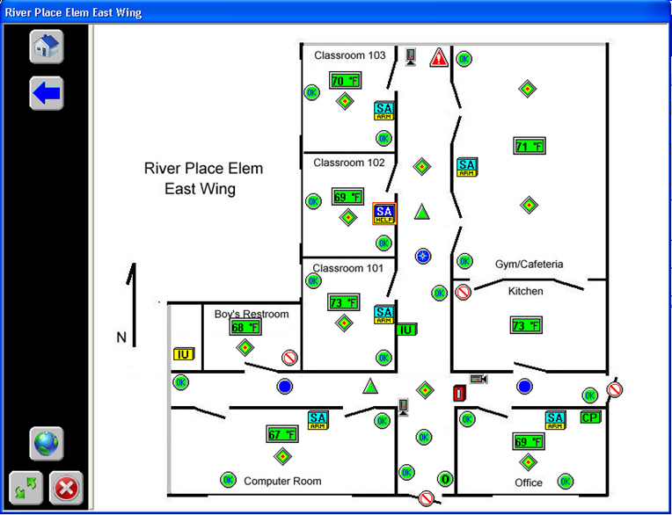
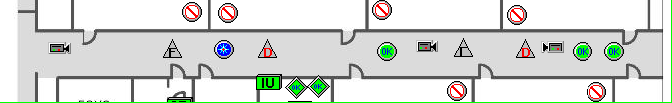
Virtual Command – An Integrated Solution
MONITORING
REAL-TIME DISPLAYS
Real-Time Actionable Intelligence– Multi Conditional Sensor States
Platform to Launch Countermeasures
Protection of Victims in Building using a Hybrid Ballistic Hardened Door
Figure 3 –Multi conditional state

Slide 11
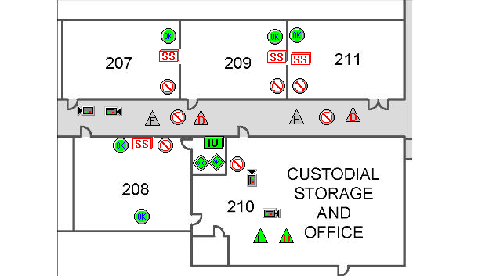





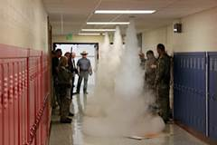
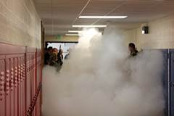
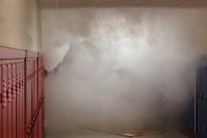
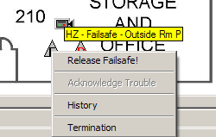
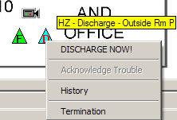
Virtual Command – An Integrated Solution
Proactive Counter Attack—Remote Countermeasure Capability-Patent Awarded
May 2016—2nd Patent Issued June 27, 2017. Received Aug. 2, 2017. 3rd Patent awarded March 20,2018
ICON | COUNTER MEASURE ICONS - DEFINITION & USE
 | Hot Zone – Chemical canister power fail safe not armed.
 | Hot Zone – Chemical canister not armed.
 | Hot Zone – Chemical canister powered fail safe armed.
 | Hot Zone – Chemical canister powered, ready for use.
 | Hot Zone – Chemical canister discharged.
Figure 7 - Counter Measures Monitoring Screen
Disp
Figure 8 - Counter Measures Released

Slide 12
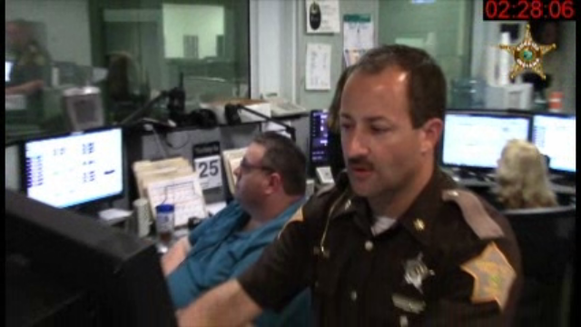
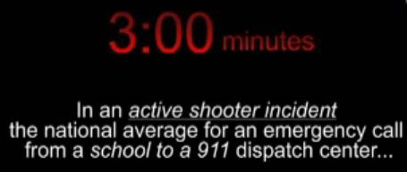
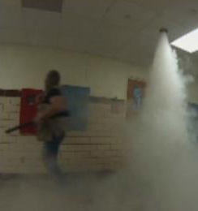
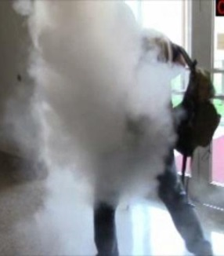
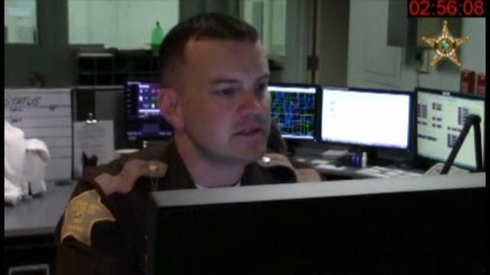
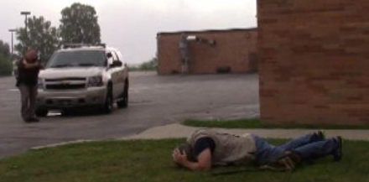
Virtual Engagement Capability within One Minute from Alert
Receive an instant alert from school
Locate and track shooter
Acquire subject description
Remotely launch counter measures within a minute

Slide 13

Indiana School Safety Guidelines for Emergency Response Systems
Governing Document for Public Law 27
Indiana School Safety Bill, Senate Bill 147 passed March 2016—Now Public Law 27—effective July 01, 2017—Encourages all schools to implement an Emergency Response System

Slide 14
Indiana 2018 Pilot/Flagship Expansion
A Total of Eight New Sites are Planned to Support the Indiana Sheriffs Fall Campaign to pass a Community based Funding bill in the 2019 Legislative Budget Session to support Public Law 27
Early Discussion—Parke, Fulton, Hendricks and Dearborn Counties
Southwestern School District Shelby County
Pike County School Corporation
Salem Schools Washington County
Jay County Schools
Prairie Heights School District Steuben County

